Slide 1
Sponsored Programs & Research Compliance and the Human Research Ethics Board
New Faculty Orientation
Thursday, October 8, 2020, 4:00 p.m.
Presented by:
Maryalice Citera, HREB Chair Catherine Hoselton, HPA
Jason Wrench, HREB Associate Chair, Interim HPA Roseann Merrill, HREB Coordinator

Slide 2
Sponsored Programs & Research Compliance (SPRC)
SPRC provides administrative support and institutional oversight for the College community in:
Applying for and managing externally funded contracts & grants
Research compliance in:
Human Subjects Research
Animal Use
Biosafety
Conflicts of Interest
Responsible Conduct of Research

Slide 3
SPRC Staff
Roseann Merrill SPRC Administrative Assistant, HREB Coordinator
Catherine L. Hoselton Assistant VP, RF Operations Manager, Human Protections Administrator | Kathie Baker SPRC Director, RF Operations Manager, RF Personnel Services Manager
Carrie A. Corti Senior Portfolio Director (Orange) | Patty Pritchard Portfolio Director (Blue)
Dulcie Fisher RF Accounts Payable & Purchasing Manager | Katelyn Welch RF Accounts Payable, Portfolio Management Assistant

Slide 4
The Human Research Ethics Board (HREB)
SUNY New Paltz’s IRB

Slide 5
Topics
HREB Mission
CITI Training
PACS System
Where to Start
What is Human Subjects Research?
Student Research Projects vs. Student Research Exercises
Exempt Research Categories
Big 4
Survey/Interview
Education
Secondary Research
Benign Behavioral Intervention
Some Issues to Consider
Specific Exclusions
Making Qualtrics Surveys Anonymous
External Site Approval
Video, Audio, and Digital Taping
Conducting Research using Amazon Turk

Slide 6
HREB Mission Statement
The mission of the Human Research Ethics Board is to protect the rights and welfare of human participants in research conducted by State University of New York at New Paltz students, faculty, and staff and by external researchers seeking to collect data on SUNY New Paltz students, faculty, and/or staff.
The HREB is a quasi-independent committee within the College working within a broader context and must follow federal, state, international, and local rules, regulations, and policies.
The HREB reports to both the Provost’s Office and Sponsored Programs and Research Compliance.
The primary task of the HREB is to review proposals and determine whether they meet ethical standards for the involvement of human participants in research. As part of the review process, the committee engages in educating the New Paltz community about techniques and best practices for protecting the rights and welfare of research study participants. This committee works within a broader context and must follow federal, state, international, and local rules, regulations, and policies.

Slide 7
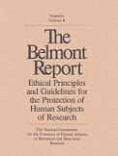
The HREB Follows the Basic Ethical Principles from The Belmont Report
Notes:
National Commission for Protection of Human Subjects of Biomedical and Behavioral Research—1979
Respect for Persons—Autonomy—People have the right to choose whether to be in a research study or not—Must make informed decisions—Persons with diminished autonomy are entitled to protection.
Beneficience—Participants should not be harmed. Research should do good. Maximize possible benefits and minimize possible harm—Risk/ Benefit ratio
Justice-benefits and risks of research must be distributed fairly—fair selection of participants and the participant pool should be able to enjoy the benefits of the outcomes of the research (drug tested on poor, but only affordable by rich?)

Slide 8
Mandatory HREB Training
All faculty, staff, and student researchers are required to complete HREB training. Faculty advisors and student research supervisors are also required to complete CITI training.
Collaborative HREB Training Initiative (CITI) program
The PACS system will check CITI training records.
SUNY New Paltz credentials and e-mail addresses must be used when registering for both CITI training and the PACS system.
Notes:
The training is good for 3 years. After 3 years, you need to do a refresher course.

Slide 9
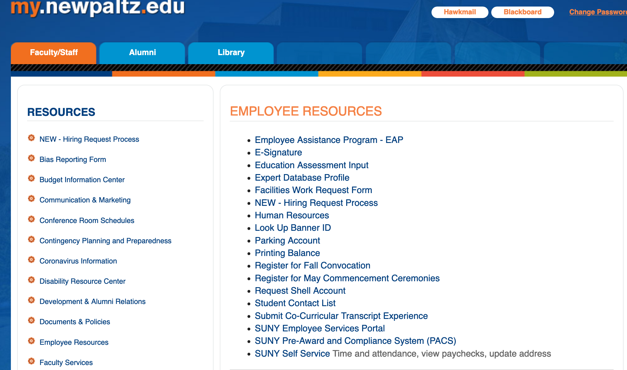
PACS
All proposals must be submitted through the PACS system.
All Faculty, Staff, and Student researchers need to sign-up for PACS accounts.
For Faculty and Staff
Sponsored Programs will set up your account. Contact Roseann and she will create the account.
For Students and External Researchers
Must do self registration following the link on the HREB webpage.
Once you have an account, you sign in to PACS using your SUNY New Paltz login information.
There is a link in my.newpaltz.edu under Employee Resources

Slide 10
HREB Documents
All documents can be found in the PACS library and on the HREB website.

Slide 11
Creating a New Study in PACS
Click on the IRB tab
Click button to Create a new study
Follow and respond to the prompts
Upload the template where it requests the protocol be uploaded
Upload supporting materials (surveys, recruiting material) where requested.

Slide 12
Creating a New Study in PACS

Slide 13
Some PACS Tips
PACS information and training videos are available at
https://www.newpaltz.edu/sponsored_programs/pacs.html
Requests for PACS accounts must be processed by Roseann. So be sure to request them in advance
PACS will check CITI training records so when creating your CITI Profile you must use your SUNY New Paltz e-mail address as your preferred CITI e-mail address.
All documents need to be loaded into the PACS submission—not in comments.

Slide 14
Where to Start
Is it Research?
No
Not Human Subjects Determination
Yes
Exempt Review
Non-Exempt Review
Full Board
Expedited Review

Slide 15
What is a Human Subject?
Human subject means a living individual about whom an investigator (whether professional or student) conducting research:
(i) Obtains information or biospecimens through intervention or interaction with the individual, and uses, studies, or analyzes the information or biospecimens; or
(ii) Obtains, uses, studies, analyzes, or generates identifiable private information or identifiable biospecimens.
Intervention includes both physical procedures by which information or biospecimens are gathered (e.g., venipuncture) and manipulations of the subject or the subject's environment that are performed for research purposes.
Interaction includes communication or interpersonal contact between investigator and subject.
Private information includes information about behavior that occurs in a context in which an individual can reasonably expect that no observation or recording is taking place, and information that has been provided for specific purposes by an individual and that the individual can reasonably expect will not be made public (e.g., a medical record).
Identifiable private information is private information for which the identity of the subject is or may readily be ascertained by the investigator or associated with the information.
An identifiable biospecimen is a biospecimen for which the identity of the subject is or may readily be ascertained by the investigator or associated with the biospecimen.
Notes:
Program Evaluation
Case Analysis
RESEARCH PROJECTS either directed or independent, which employ systematic
data collection with the intent to contribute to generalizable knowledge.
RESEARCH EXERCISES, the goal of which is to provide research training

Slide 16
What is Research?
Research means a systematic investigation, including research development, testing, and evaluation, designed to develop or contribute to generalizable knowledge.
Activities that meet this definition constitute research for purposes of this policy, whether or not they are conducted or supported under a program that is considered research for other purposes. For example, some demonstration and service programs may include research activities.
45 CFR 46, Section 102(l)
Notes:
Program Evaluation
Case Analysis
RESEARCH PROJECTS either directed or independent, which employ systematic
data collection with the intent to contribute to generalizable knowledge.
RESEARCH EXERCISES, the goal of which is to provide research training

Slide 17
Activities Deemed Not to be Research 1
(1) Scholarly and journalistic activities (e.g., oral history, journalism, biography, literary criticism, legal research, and historical scholarship), including the collection and use of information, that focus directly on the specific individuals about whom the information is collected.

Slide 18
Activities Deemed Not to be Research 2
(2) Public health surveillance activities, including the collection and testing of information or biospecimens, conducted, supported, requested, ordered, required, or authorized by a public health authority. Such activities are limited to those necessary to allow a public health authority to identify, monitor, assess, or investigate potential public health signals, onsets of disease outbreaks, or conditions of public health importance (including trends, signals, risk factors, patterns in diseases, or increases in injuries from using consumer products). Such activities include those associated with providing timely situational awareness and priority setting during the course of an event or crisis that threatens public health (including natural or man-made disasters).

Slide 19
Activities Deemed Not to be Research 3
(3) Collection and analysis of information, biospecimens, or records by or for a criminal justice agency for activities authorized by law or court order solely for criminal justice or criminal investigative purposes.

Slide 20
Activities Deemed Not to be Research 4
(4) Authorized operational activities (as determined by each agency) in support of intelligence, homeland security, defense, or other national security missions.

Slide 21
Who Determines if A study Involves human subjects Research?
The researcher is empowered to make this determination based on these definitions.
If the researcher is unsure or would prefer an official determination, the HREB can make the determination.
In this case, the researcher would submit a request through PACS.

Slide 22
Are student projects Human Subjects Research?
The answer to this question is it depends.
The HREB makes a distinction between Student Research Projects and Student Research Exercises.

Slide 23
Distinction between Research Studies and Class Research Exercises
Research Projects
Research Exercise
Intended to contribute to generalizable knowledge
Presentation at conferences for external audiences
Submission of research project in full or partial completion of graduate degree requirements
Submission of article for publication, competition, dissemination
Practice with a research technique or professional writing style
Presentation limited to the SUNY New Paltz community with appropriate disclaimer
Paper or manuscript for grade by faculty member, but is not accessible for review by those outside of the class with the exception of accrediting/auditing bodies.
Contained within the classroom
Data destroyed at end of semester
Cannot be published or presented outside of SUNY New Paltz

Slide 24
Class Projects—Can receive HREB approval
We have a program where instructors can be trained as Exempt Reviewers
They conduct the review of their student’s research using the same standards as any other Exempt research.
The approval they give their students is recognized as HREB approval.
Can be published or presented anywhere
Note: Only Exempt proposals (that do not require limited HREB review) can be approved by certified instructors. Expedited proposals, Full Board, and Exempt proposals with limited HREB review must be reviewed by the HREB

Slide 25
Exempt Categories*
1. Research in Established or Commonly Accepted Education Settings that Involves Normal Educational Practices
2. Research only includes Educational Tests, Surveys, Interviews, Public Observation if at least ONE of the criteria are met.
3. Research involving Benign Behavioral Interventions (BBI) through verbal, written responses, (including data entry or audiovisual recording) from adult subject who prospectively agrees and at least ONE of the criteria are met.
4. Secondary Research for Which Consent is Not Required: Use of Identifiable Information or Identifiable Biospecimen that have been or will be collected for some other ‘primary’ or ‘initial’ activity, if ONE of the criteria are met:
5. Research and demonstration projects supported by a Federal Agency/Dept. AND Designed to study, public benefit or service programs.
6. Taste and food quality
7. Storage or Maintenance of Identifiable Private Information or Identifiable Biospecimens for Secondary Research For Which Broad Consent Is Required
8. Secondary research involving use of Identifiable Private Information or Identifiable Biospecimens for Which Broad Consent was Required

Slide 26
Exempt Categories
Big 4
Educational
Survey and Interview Research
Benign Behavioral Interventions
Existing Data

Slide 27
Criteria: For Survey/Interviews and Benign Behavioral Intervention
Recorded information cannot readily identify the subject (directly or indirectly/linked): OR
Any disclosure of responses outside of the research would NOT reasonably place subject at risk (criminal, civil liability, financial, employability, educational advancement, reputation); OR
Information is recorded with identifiers & IRB conducts Limited Review

Slide 28
Criteria: For Secondary Research
Biospecimens or Information is Publicly Available; OR
Information recorded so subject cannot readily be identified (directly or indirectly/linked); Investigator does not contact subjects and will not re-identify the subjects; OR
Collection and Analysis involving Investigators Use of Identifiable Health Information when use is regulated by HIPAA “health care operations” or “research” or “public health activities and purposes”; OR
Research information collected by or on behalf of federal government using government generated or collected information obtained for non-research activities.

Slide 29
Limited HREB Review
Limited IRB review is a process that is required only for certain exemptions. In limited IRB review, the IRB must determine that certain conditions, primarily that adequate provisions are in place to protect the privacy of subjects and maintain confidentiality of the data, are met.

Slide 30
Some Specific Issues to Consider

Slide 31
Some Specific Exclusions
Subpart B: Studies Involving Pregnant Women, Fetuses & Neonates are Eligible for Exempt Under All 8 Categories
Subpart C: Exemptions Do Not Apply to Research Involving Prisoners Except “for Research Aimed at Involving a Broader Subject Population that Only Incidentally Includes Prisoners”
Subpart B: Children are allowed in categories 1,4,5,6,7, & 8; Limitations & Exclusion of Children in Category 2 & 3

Slide 32
Making Qualtrics Surveys Anonymous

Slide 33
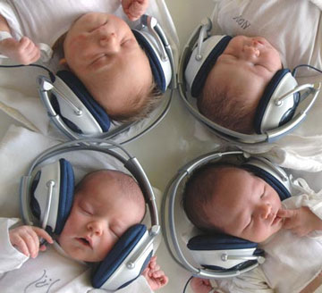
External Site Approval Required
For all research conducted in external sites like schools, organizations, hospice care, nursing homes, hospitals, etc.., the highest ranking official or designee of the site must provide written approval for the study to be conducted at the site.
This must be obtained after the study has been approved by the HREB
Notes:
This is a local policy—But resulted from flack raised by school districts when study was being conducted and the superintendent was unaware of the study.

Slide 34
Video, Audio, and Digital Taping
The HREB does not consider these to be anonymous
They require Limited HREB review
Consent to record video, audio, or digital images is necessary.
Students in classrooms present particular concerns
Notes:
You should avoid this if you can

Slide 35
Research Using Amazon Mechanical Turk
MTurk functions as a virtual labor market where registered Workers complete online Human Intelligence Tasks (HITs) for pay.
HREB has recommendations for using Mechanical Turk

Slide 36
Questions

Slide 37
Contact Information
Catherine Hoselton - hoseltoc@newpaltz.edu
Jason Wrench - wrenchj@newpaltz.edu
Maryalice Citera - HREBchair@newpaltz.edu
Roseann Merrill – HREBcoordinator@newpaltz.edu
Website:
http://www.newpaltz.edu/sponsored_programs/humansubs.html
Resources
Office of Human Research Protections
http://www.hhs.gov/ohrp/
Notes:
U.S. Department of Health and Human Services

